Slide 1
Computer Crimes
Hacking/CFAA

Slide 2
Hacking
https://www.youtube.com/watch?v=U2_h-EFlztY

Slide 3
Criminal Law Origins CFAA
Computer Fraud and Abuse Act (CFAA)
Enacted in 1986

Slide 4
CFAA
Applies to “Protected Computers”:
exclusively for the use of a financial institution or the United States Government; or
which is used in or affecting interstate or foreign commerce or communication, including a computer located outside the United States

Slide 5
CFAA – Using Computers for fraud
”knowingly and with intent to defraud, accesses a protected computer without authorization, or exceeds authorized access, and by means of such conduct furthers the intended fraud and obtains anything of value . . .”

Slide 6
CFAA – Unauthorized Access
knowingly causes the transmission of a program, information, code, or command, and as a result of such conduct, intentionally [or recklessly] causes damage without authorization
intentionally accesses a protected computer without authorization, and as a result of such conduct, causes damage and loss.

Slide 7
CFAA – Civil Remedies
Any person who suffers damage or loss by reason of a violation of this section may maintain a civil action against the violator to obtain compensatory damages and injunctive relief or other equitable relief.

Slide 8
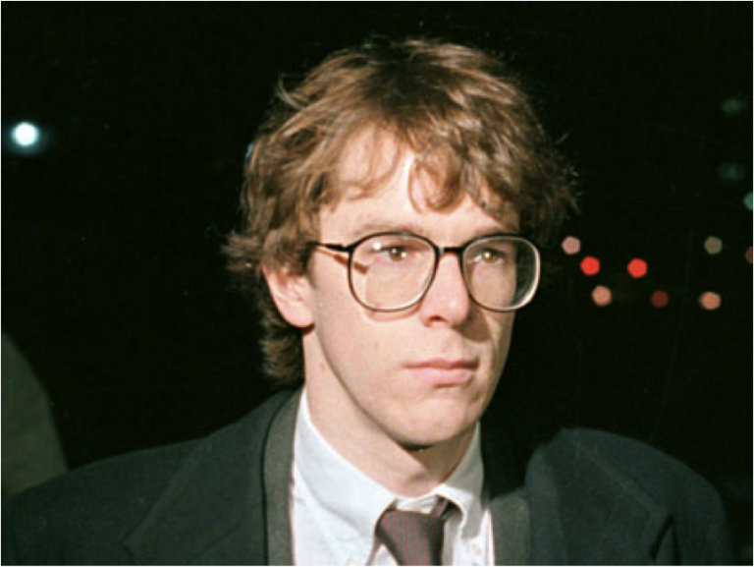
Case Example 1 – Computer Worm United States v. Morris
Morris was a Cornell University computer science doctoral student.
He released a worm over the Internet.
A worm is a self-replicating computer program designed to spread over the Internet without any further human interaction with the program once it is released.

Slide 9
The Design of the Worm
Morris designed the worm to copy itself from Internet system to Internet system; however, before it copied itself, the worm first asked the computer if it already had a copy of the worm.
Point: multiple copies would slow the computer down and make the computer owner aware of the worm’s presence.
Morris wanted to show that the worm could spread undetected.

Slide 10
The Design of the Worm
The worm did not copy itself if it got a “yes” answer.
However, Morris also worried that system owners who became aware of the worm would stop its spread by programming their computers to answer “yes.”
So he programmed the worm to copy itself every seventh time it received a “yes” from the same computer.

Slide 11
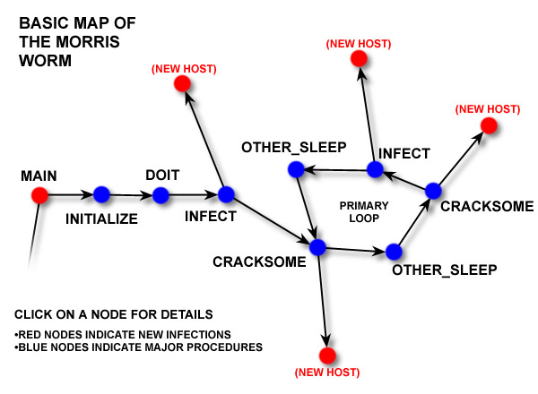

Slide 12
Purpose of the Morris Worm
Morris did not intend his worm to cause any harm.
As the court notes, “The goal of this program was to demonstrate the inadequacies of current security measures on computer networks by exploiting the security defects that Morris had discovered. The tactic he selected was release of a worm into network computers.”

Slide 13
The Error
Morris greatly underestimated the number of times a computer would be asked if it had the worm.
The worm spread with great rapidity over the Internet causing computer slowdowns and shutdowns and imposing on system owners the cost of removing the worm.
It infected about 10% all internet-connected computers (about 6,000)
The internet had to be partitioned in order to remove the worm.

Slide 14
Computer Fraud and Abuse Act
Morris was prosecuted criminally under the Computer Fraud and Abuse Act.
In fact, he was the very first person to be so prosecuted

Slide 15
The Issues
The court: “The issues raised are (1) whether the Government must prove not only that the defendant intended to access a federal interest computer, but also [whether defendant also intended to cause loss or damage]; and (2) what satisfies the statutory requirement of ‘access without authorization.’”

Slide 16
The Ruling
The court holds that the only intent required is the intent to access the system.
The authorization issue: Morris was authorized to use—in certain ways--the computers he initially accessed. He exceeded his authorized access. Is this enough to make his access unauthorized?
The court answers that it is.

Slide 17
Terms of Service
Terms of Service – rules that a user must agree to abide by in order to use a service. As most websites provide a “service” these sites utilize TOS with their users.
The legal status of TOS continues to be unclear. Generally they are considered to be non-binding (i.e. not contracts).

Slide 18
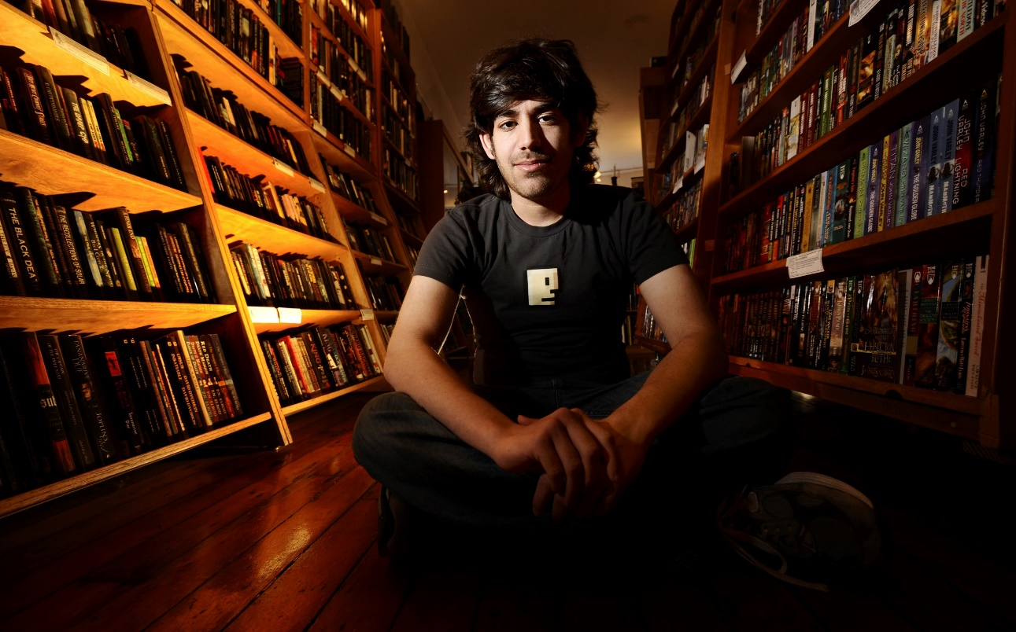
Case Example 2 – Aaron Swartz
Aaron Swartz was an MIT student.
He was also research fellow at Harvard University.

Slide 19
TOS – Aaron Swartz
Harvard gave Swartz a JSTOR account as part of his job.
http://www.jstor.org/
JSTOR is an online database of academic journals and other data
JSTOR owns the copyright to ALL of the manuscripts contained therein

Slide 20
TOS – Aaron Swartz
Swartz downloaded a large number of academic articles from JSTOR through MIT’s network.
Swartz had written a Guerilla Manifesto that said:
“We need to take information . . . make our copies and share them with the world. We need to take stuff that's out of copyright and add it to the archive. We need to buy secret databases and put them on the Web. We need to download scientific journals and upload them to file sharing networks.“
Swartz secretly attached a laptop to MIT’s computer network allowing him to "rapidly download an extraordinary volume of articles from JSTOR.“
Prosecutors in the case said Swartz acted with the intention of making the papers available on P2P file-sharing sites.
However, Swartz did not do so and returned all the files to JSTOR after he was caught.

Slide 21
TOS – Aaron Swartz
Swartz was indicted on 11 charges of violating the CFAA, facing 35 years in jail.
The Manifesto played a key role in the prosecutor’s decision.
But Swartz was never convicted. He committed suicide in 2013.

Slide 22
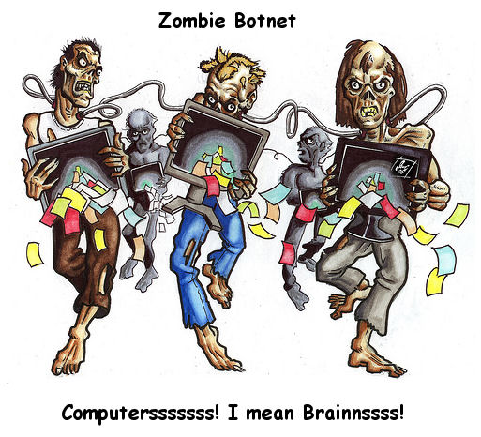
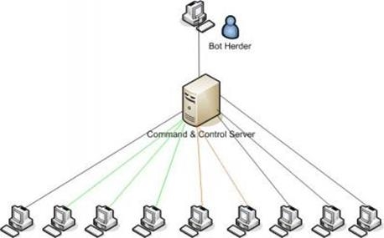
Case Example 3 - Botnets
What is a Botnet?
a network of private computers infected with malicious software and controlled as a group without the owners' knowledge

Slide 23
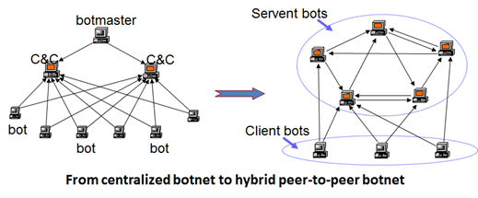
Peer-to-Peer Botnet

Slide 24
Purposes of Botnets
DDOS (Domain Denial-of-Service) Attacks
Spamming
Implement Fraud Scheme (Banking information gathering)

